Slide 1
Capstone Project
Hotel Booking Analysis
Project Done By:
Vivek Kumar Singh

Slide 2
Problem Statement:
We have got the data of a Hotel’s booking system .There are two types of hotels ‘resort hotel’ and ‘city hotel’ Our goal is to find and extract meaningful insights from data. Using these insights hotels can take steps to attract more customers and thus increase their profits thereby.

Slide 3
Data Summary:
hotel : There is two type of Hotel one is Resort Hotel and the other is City Hotel
is_canceled : It gives the status if the booking wheter it has been cancelled or not
lead_time : It gives the difference in days between booking and the arrival of the customer
arrival _date_year : Gives year in which the visitor arrived
arrival _date_month : Gives month in which the visitor arrived
stays_in_weekend_nights : Number of weekend nights spent i.e. Saturday and Sunday
stays_in_week_nights: Number of week nightsspent i.e. Monday to Friday
adults : Number of adults per booking

Slide 4
Data Summary:
children : Number of children per booking
babies : Number of babies per booking
meal : Type of meal preferred by customers
country : Country of origin of visitor
market_segment : group of people based on market
distribution_channel : Name of the distribution channel
is_repeated_guest : Tells wheter the guest is a repeat customer or first time visitor.
previous_cancellations : Number of previous bookings that were cancelled by the customer prior to the current booking

Slide 5
Data Summary:
previous_bookings_not_canceled : Number of previous bookings not canceled by the customer prior to the current booking
reserved_room_type :Type of room reserved
assigned_room_type : Type of room assigned during booking
booking_changes : Number of bookings changed
deposit_type : Types of deposit
agent : Gives the ID of the agent
company : Gives the ID of the Company related to the booking
day_in_waiting_list : Number of days the booking was in the waiting list before confirmation
customer_type : Type of customer

Slide 6
Data Summary:
adr : average daily rate
required_car_parking_spaces :Number of car parking spaces required by the customer
total_of_special_requests : Gives the number of special requests made by the customer
reservation_status : Gives the status of the reservation
reservation_status_date : Date at which the last status was updated

Slide 7
What is EDA?
Exploratory Data Analysis is the crictical process to perform initial investigations on data so as to discover patterns, to spot anomalies to check assumptions with the help of summary statistics and graphical representations.
IMPORTANCE:
It is very useful in understanding the data .The insights generated are critical and helpful in decision making.

Slide 8
Approach:
Approach the problem in simple steps:
Understanding the Data
Data Pre-Processing
Formulate Questions about the Data
Performing Exploratory Data Analysis (EDA)
Answer the questions based on analysis and draw out the conclusions.

Slide 9
Data Pre-Processing
Viewing Data :
Firstly we look at all the columns as what they represent and check the overall shape of the data
Secondly we check the data type of each column to see what type of data we are going to deal with.
Cleaning the Data:
We check the null or missing values and fill the numerical missing values with zero or mean value if the column data has arithmetical significance and categorical ones with mode.
We delete the rows having cancelled bookings

Slide 10
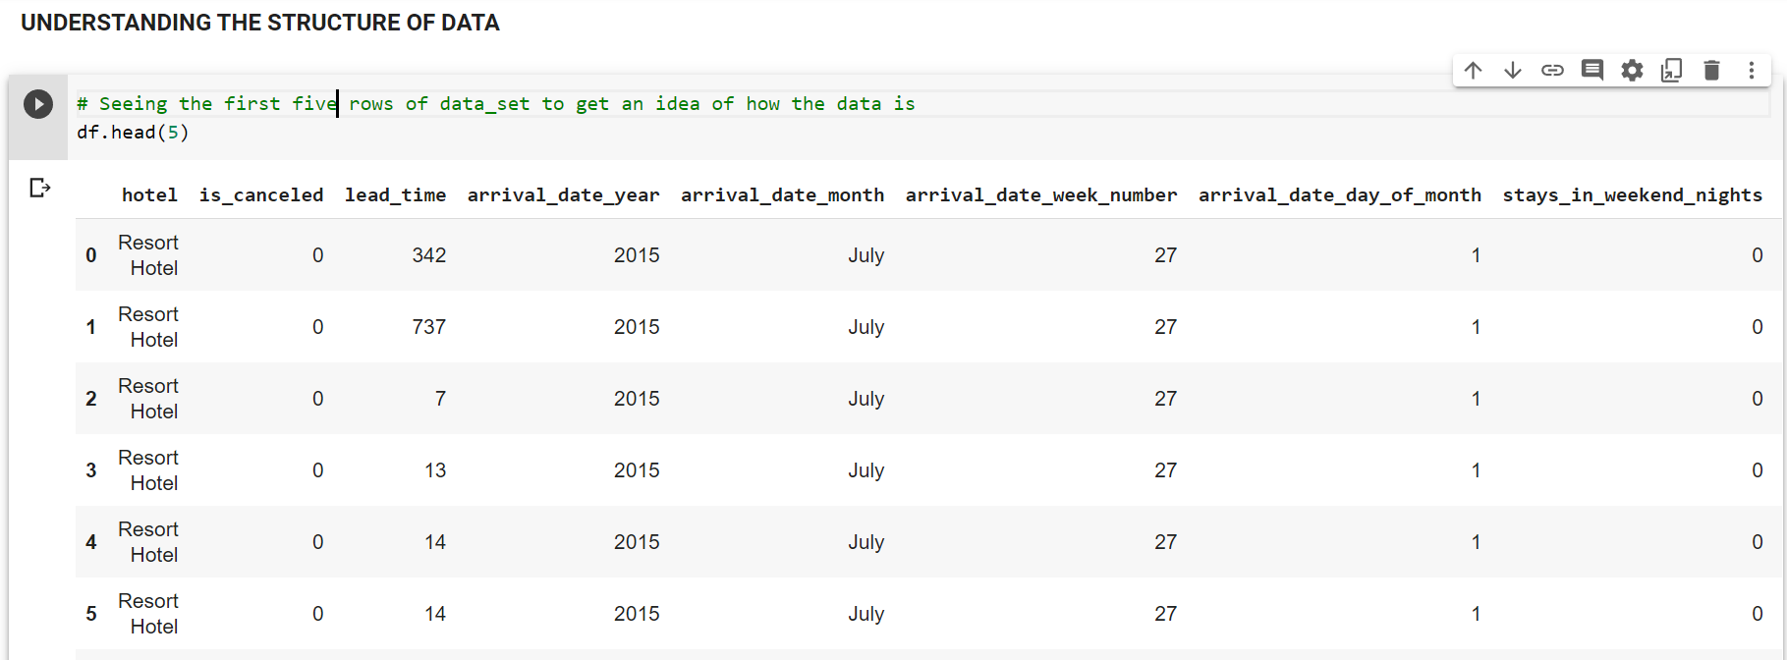
Viewing the Data :
Quick look:
Size of data : (119390, 32) => 119390 rows and 32 features
Viewing first 5 rows

Slide 11
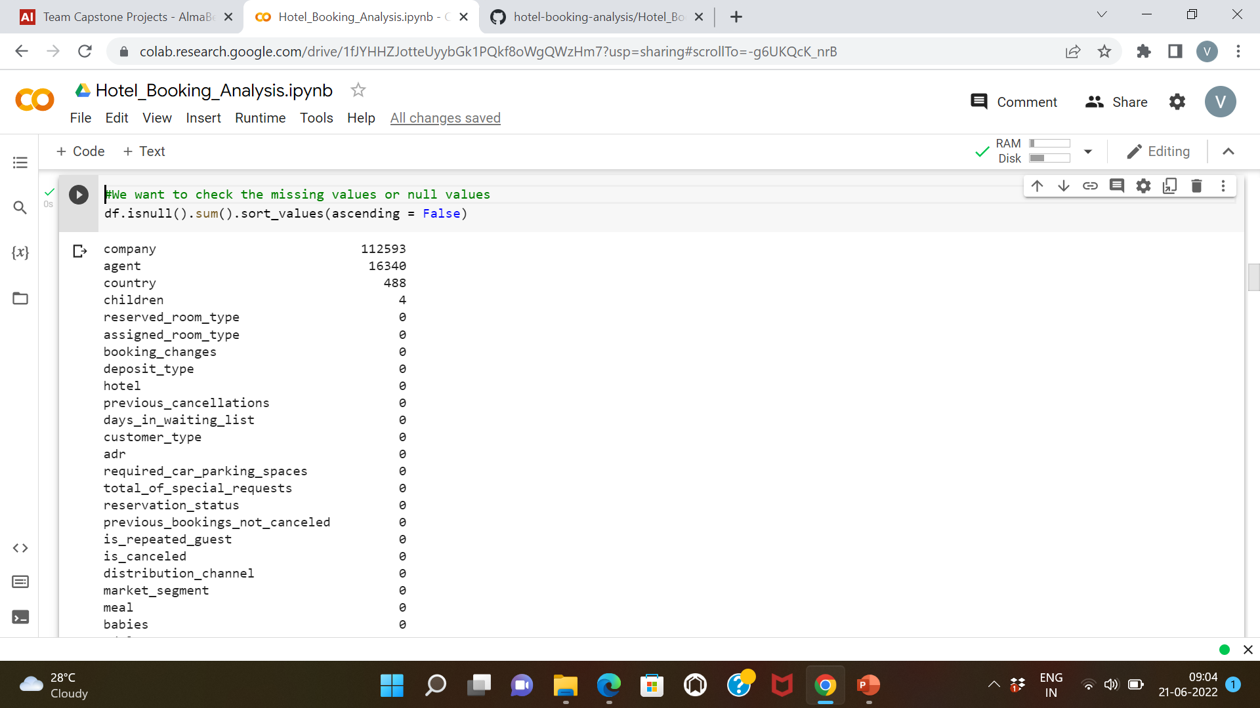
Data Cleaning:
Checking The Missing or Null values:

Slide 12
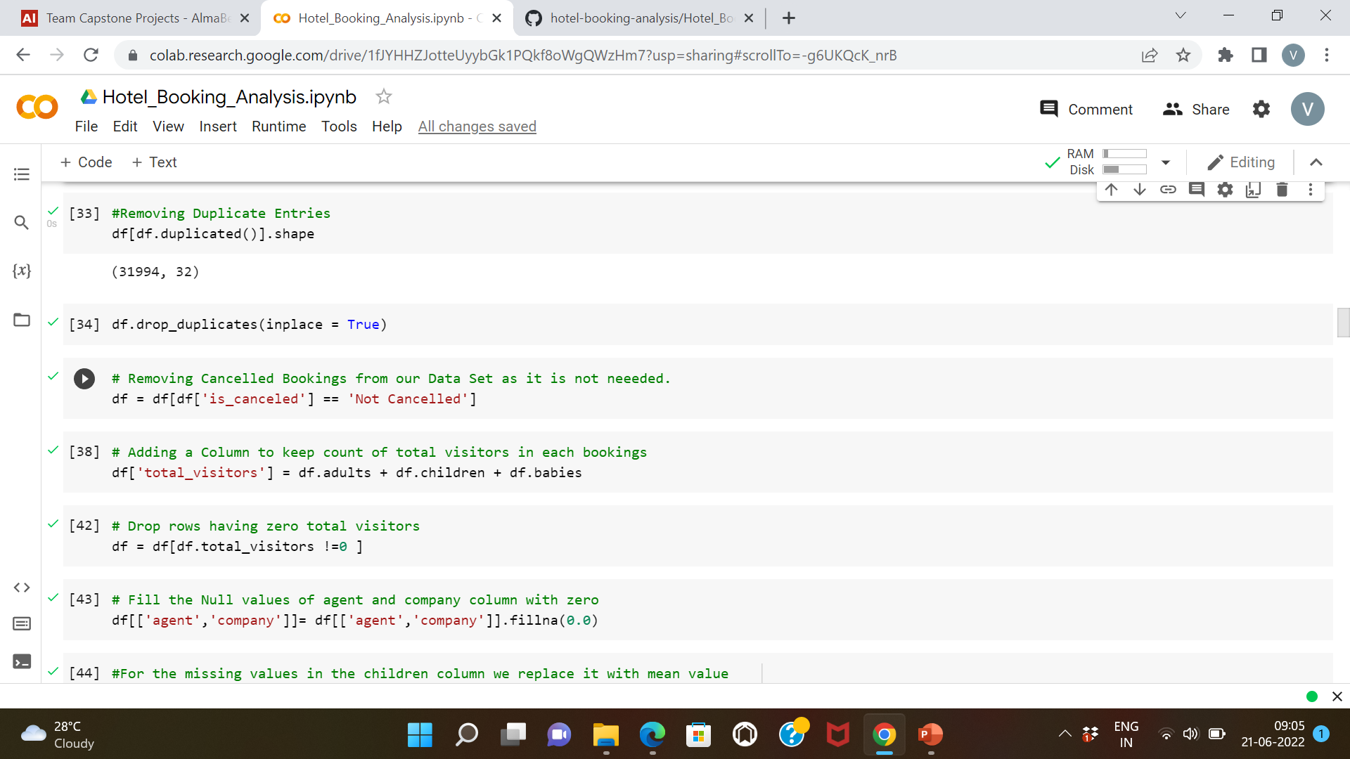
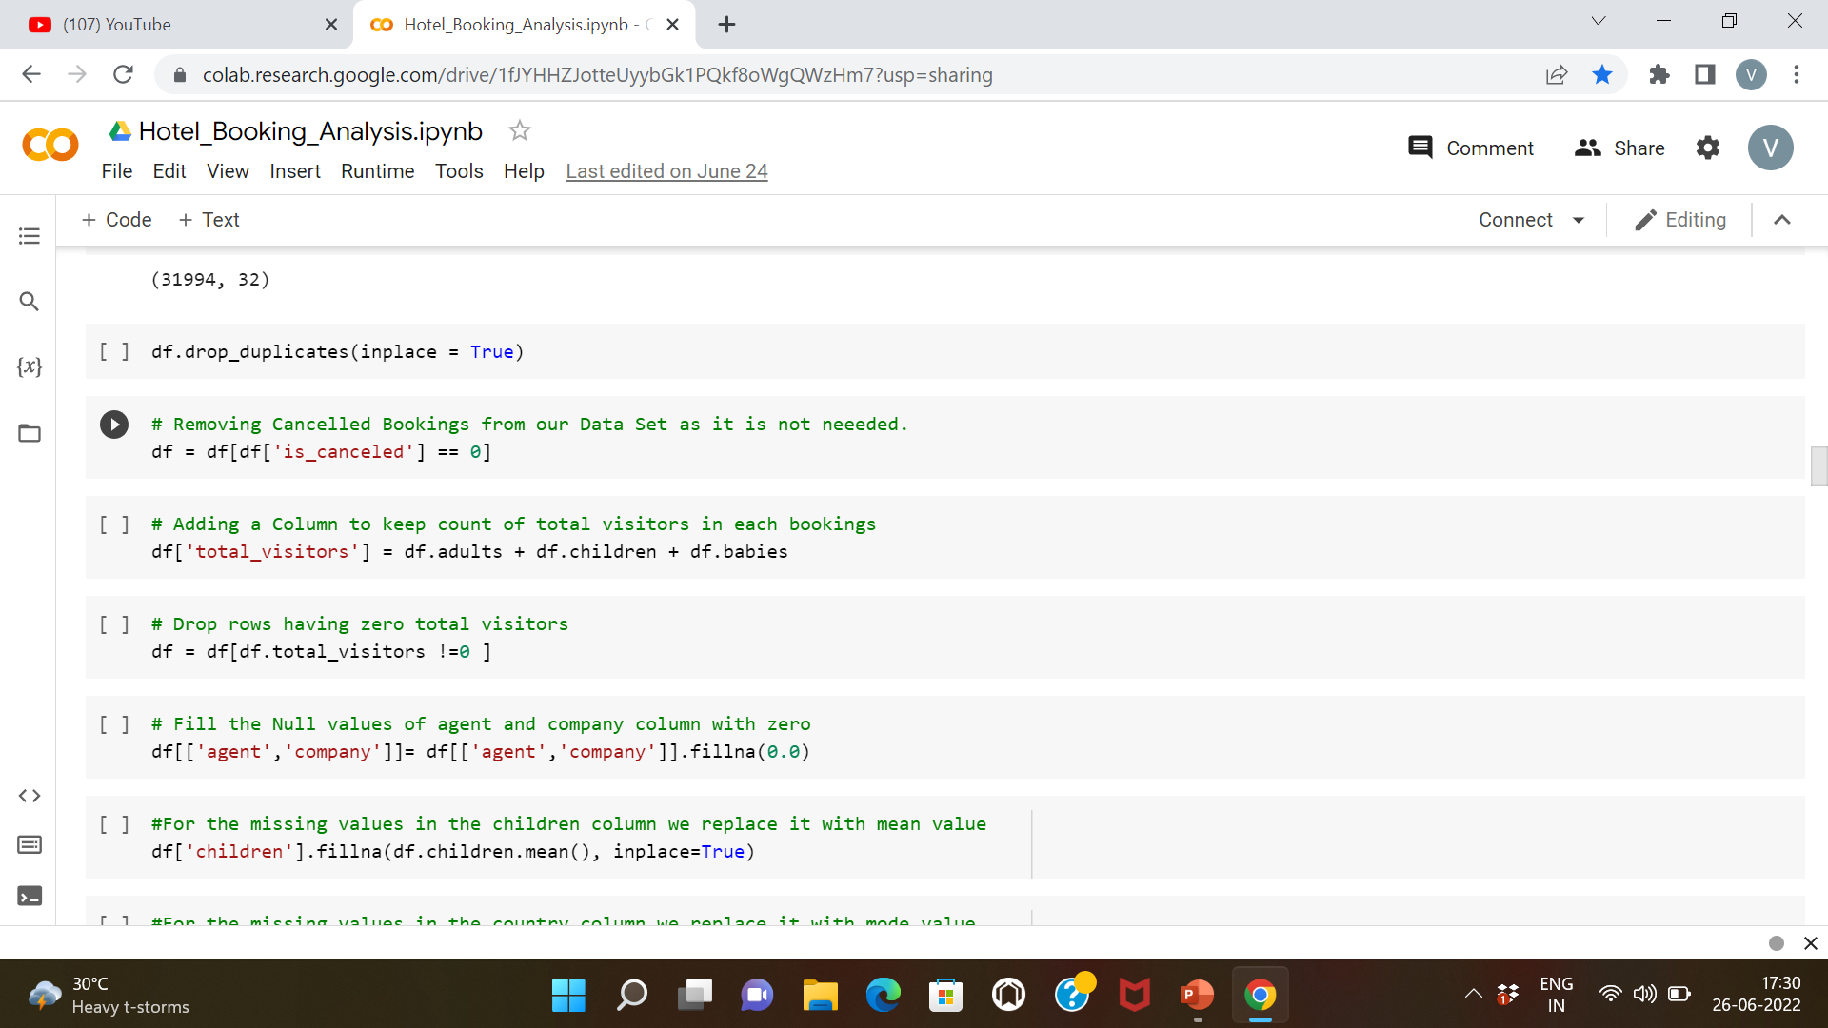
Data Cleaning:
Checking and Dropping Duplicate Rows:
Removing Cancelled bookings from our Dataset

Slide 13
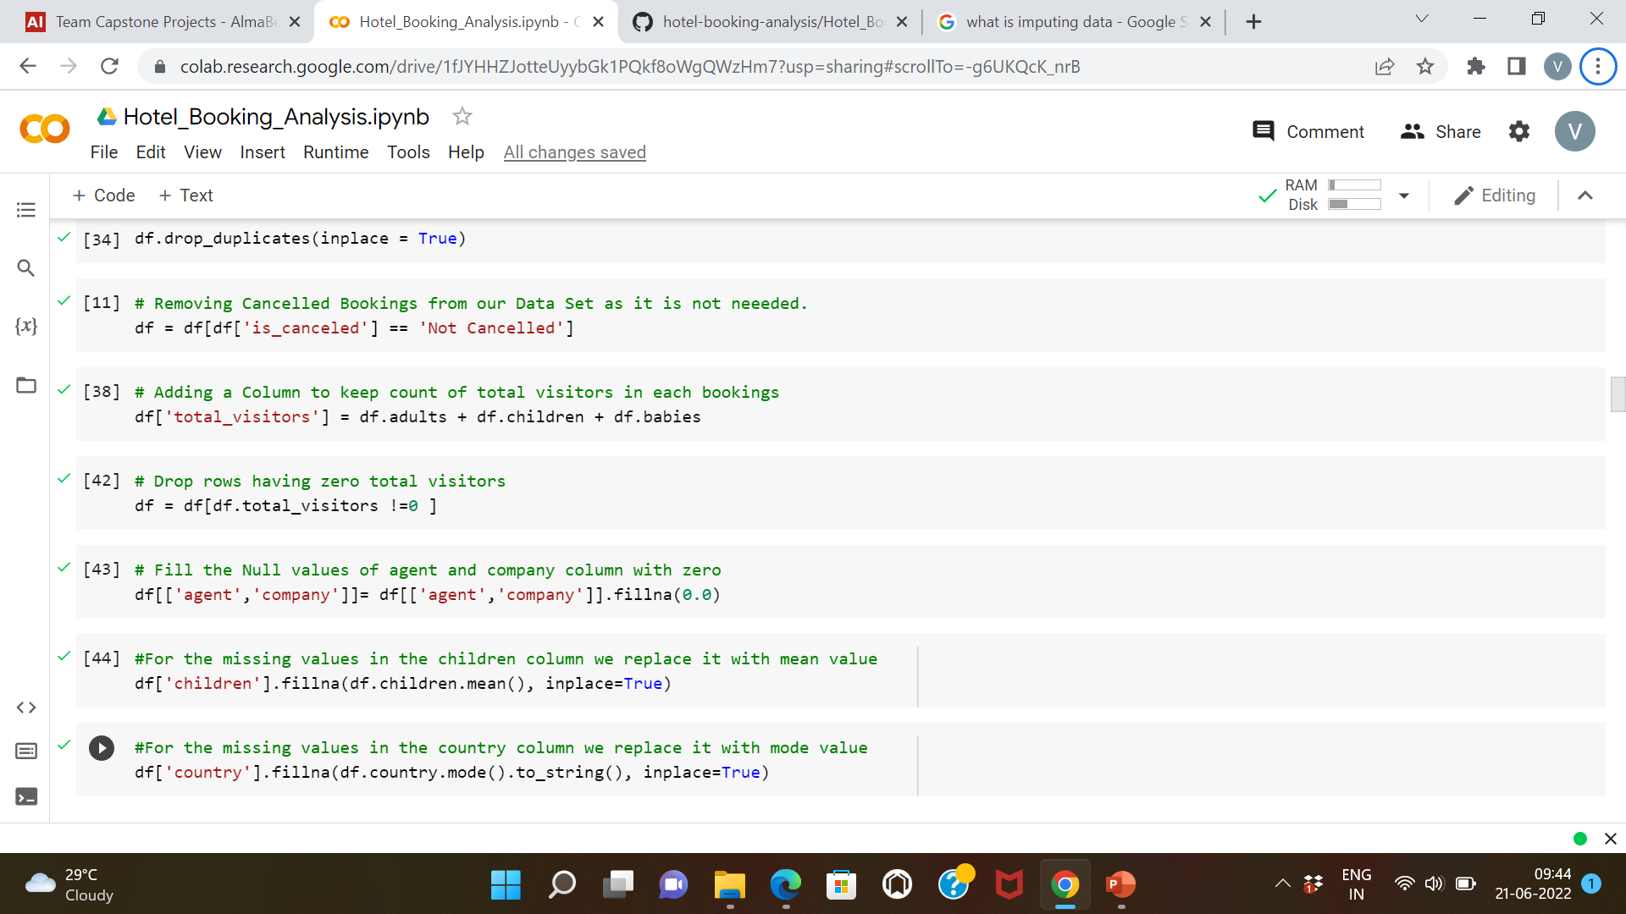
Data Cleaning:
Dropping Rows without any visitor:
Imputing Data :

Slide 14
Problem Formulation:
What is the booking ratio between the two types of Hotels?
What is the trend of Hotel Bookings by Months?
What is the trend of Hotel Bookings by Year?
Top ten countries by most visitors in Hotels
Which type of hotel is most preferred Hotel For Babies?
What is the Preferred Meal type?
Which Market Segment contribute most to Hotel Bookings?
Which type of room is allotted most
Who are the Top ten performing agents?
What is the share of Distribution channel in Hotel Bookings?
What is the Average Daily Rate of Hotels by Months?
What Number of Visitors are Repeat Guests and how many are Non Repeat Guests?
What is the Correlation between the Variables?

Slide 15
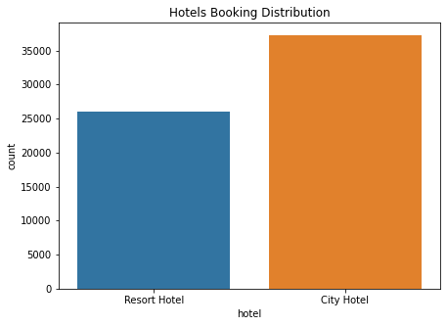
Exploratory Data Analysis(EDA)
What is the booking ratio between the two types of Hotels?

Slide 16
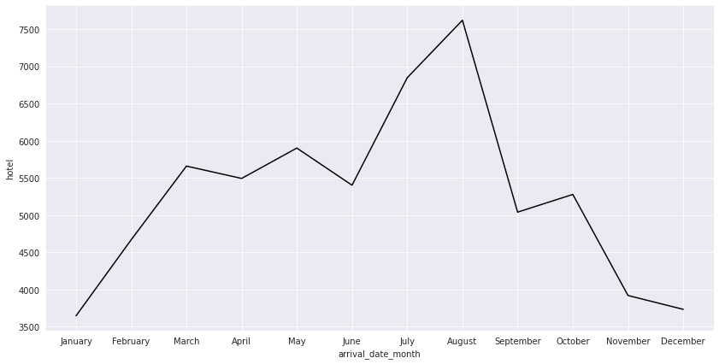
Exploratory Data Analysis(EDA)
What is the trend of Hotel Bookings by Months?

Slide 17
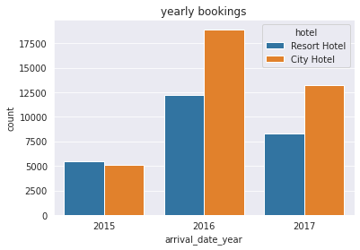
Exploratory Data Analysis(EDA)
What is the trend of Hotel Bookings by year?

Slide 18
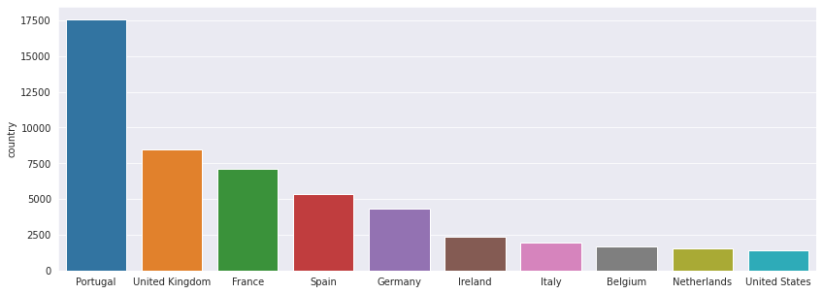
Exploratory Data Analysis(EDA)
Top ten countries with most visitors

Slide 19
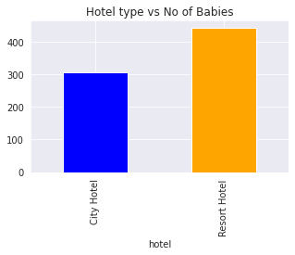
Exploratory Data Analysis(EDA)
Which type of hotel is most preferred Hotel For Babies?

Slide 20
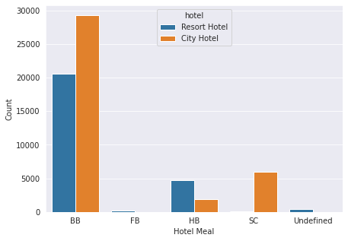
Exploratory Data Analysis(EDA)
What is the Preferred Meal type?

Slide 21
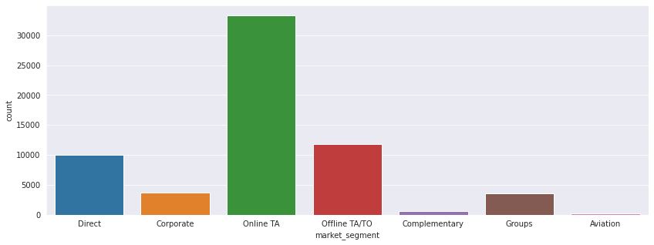
Exploratory Data Analysis(EDA)
Which Market Segment contribute most to Hotel Bookings?

Slide 22
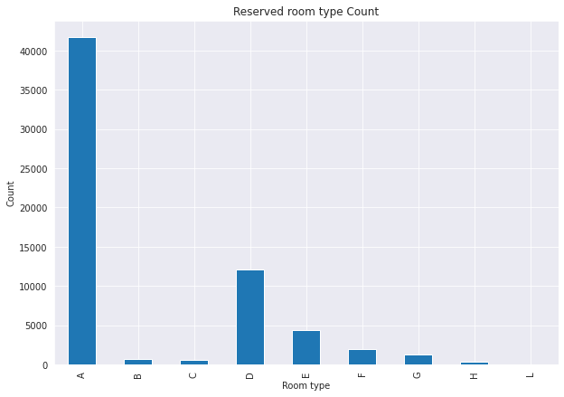
Exploratory Data Analysis(EDA)
Which Room type is alloted most ?

Slide 23
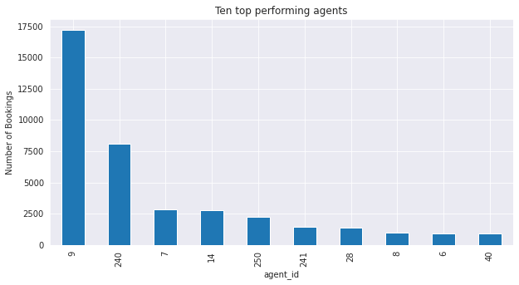
Exploratory Data Analysis(EDA)
Who are the Top ten performing agents?

Slide 24
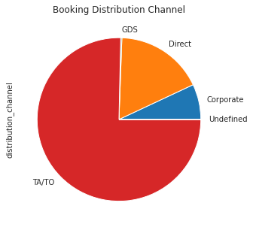
Exploratory Data Analysis(EDA)
What is the share of Distribution channel in Hotel Bookings?

Slide 25
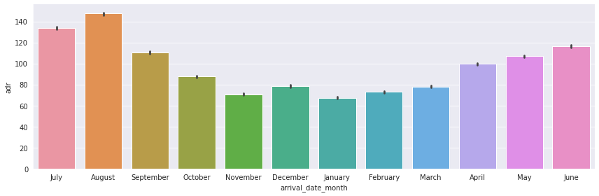
Exploratory Data Analysis(EDA)
What is the Average Daily Rate of Hotels by Months?

Slide 26
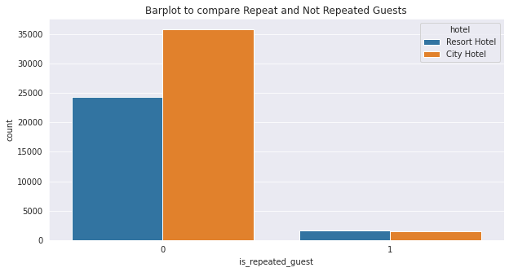
Exploratory Data Analysis(EDA)
What Number of Visitors are Repeat Guests and how many are
Non Repeat Guests?

Slide 27
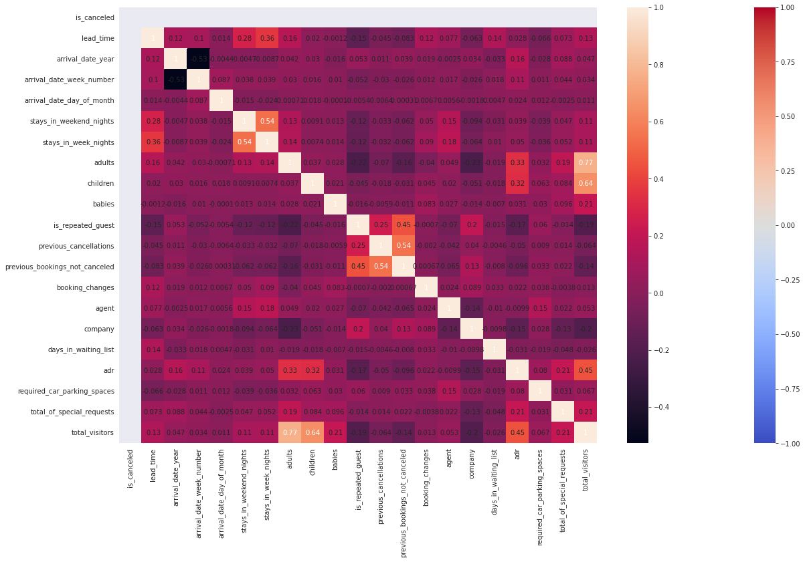
Exploratory Data Analysis(EDA)
What is the Correlation between the Variables?

Slide 28
Conclusions:
The City hotel is booked much more than the Resort Hotel
The Bookings consistently increases from January to May ,then decreases in June and consistently increases till August and the sale reaches its peak and then almost consistently decreases then after.
We observe that the sales were lowest in year 2015 increased in 2016 but again decreased in 2017.
Most Visitors came to Hotel from Portugal.
The number of babies in city hotel vs resort hotel, and we conclude that the number of babies arriving in the city hotel is much less though the city hotel has much more overall bookings.
BB type meal is most preferred.
The online market segment contributes most to the Hotel Bookings
Room type ‘A’ is allotted most.
The agent with agent id ‘9’ performs best.
The share of TA/TO distribution channel is most
The average daily rate of August is most?
The Repeat Customers are significantly minute in comparison to Non Repeating Customers
The correlation matrix plot shows the correlation between every variable pair.

